Slide 1
DB2 Documentation

Slide 2
ER

Slide 3
Logical Data Model

Slide 4
Trigger Design and Code

Slide 5
ORM Relationship Design

Slide 6
Relationship «Purchase»
Purchase
Customer
Order
Customer → Order @OneToMany is necessary to show a list of the rejected orders
Order → Customer @ManyToOne is not necessary, because there’s no scenario where from the Order we have to retrieve the Customer
Unidirectional 1:N → Use JPQL queries to retrieve the Customer’s rejected orders
0,N
1,1
Customer
*
Order
Customer
1
Order

Slide 7
Relationship «OrderedServicePackage»
OrderedServicePackage
Order
Service Package
Order → Service Package @ManyToOne is necessary to show the Customer’s selected Service Package in the rejected Order
Service Package → Order @OneToMany is not necessary, because there’s no scenario where from the Service Package we have to retrieve the Order
Unidirectional N:1 → @ManyToOne in Order entity
FetchType.EAGER
No Cascading
1,1
0,N
Order
1
Service Package
Order
*
Service Package

Slide 8
Relationship «OrderedOptionalProduct»
OrderedOptionalProduct
Order
Optional Product
Order → Optional Product @ManyToMany is necessary to show the Customer’s selected Optional Products in the rejected Order
Service Package → Order @ManyToMany is not necessary, because there’s no scenario where from the Optional Products we have to retrieve the Order
Unidirectional N:M → @ManyToMany in Order entity
FetchType.EAGER
No Cascading
0, N
0,N
Optional Product
*
Order
Optional Product
*
Order

Slide 9
Relationship «OptionalProductsAvailability»
OptionalProductsAvailability
Service Package
Optional Product
Service Package → Optional Product @ManyToMany is necessary to show to the Customer the available Optional Products for a certain Service Package
Optional Product → Service Package @ManyToMany is not necessary, because there’s no scenario where from the Optional Products we have to retrieve the Service Package
Unidirectional N:M → @ManyToMany in Service Package entity
FetchType.EAGER
No Cascading
0, N
0,N
Optional Product
*
Service Package
Optional Product
*
Service Package

Slide 10
Relationship «ValidityPeriodAvailability»
ValidityPeriodAvailability
Service Package
Validity Period
Service Package → Validity Period @ManyToMany is necessary to show to the Customer the available Validity Period for a certain Service Package
Validity Period → Service Package @ManyToMany is not necessary, because there’s no scenario where from the Validity Period we have to retrieve the Service Package
Unidirectional N:M → @ManyToMany in Service Package entity
FetchType.EAGER
No Cascading
1, N
0,N
Validity Period
*
Service Package
Validity Period
*
Service Package

Slide 11
Relationship «ServicePackageComposition»
ServicePackageComposition
Service Package
Service
Service Package → Service @ManyToMany is necessary to show to the Customer the available Services for a certain Service Package
Service → Service Package @ManyToMany is not necessary, because there’s no scenario where from the Service we have to retrieve the Service Package
Unidirectional N:M → @ManyToMany in Service Package entity
FetchType.EAGER
No Cascading
1, N
0,N
Service
*
Service Package
Service
*
Service Package

Slide 12
Relationship «OrderedValidityPeriod»
OrderedValidityPeriod
Order
Validity Period
Order → Validity Period @ManyToOne is necessary to show to the Customer the Validity Period for a certain Order
Validity Period → Order @OneToMany is not necessary, because there’s no scenario where from the Validity Period we have to retrieve the Order
Unidirectional N:1 → @ManyToOne in Order entity
FetchType.EAGER
No Cascading
1, 1
0,N
Validity Period
1
Order
Validity Period
*
Order

Slide 13
Relationship «OrderedValidityPeriod»
OrderedValidityPeriod
Order
Validity Period
Order → Validity Period @ManyToOne is necessary to show to the Customer the Validity Period for a certain Order
Validity Period → Order @OneToMany is not necessary, because there’s no scenario where from the Validity Period we have to retrieve the Order
Unidirectional N:1 → @ManyToOne in Order entity
FetchType.EAGER
No Cascading
1, 1
0,N
Validity Period
1
Order
Validity Period
*
Order

Slide 14
Relationship «AlertCustomer»
AlertCostumer
Customer
Alert
Customer → Alert @OneToOne is necessary to show to the Customer the Alert for the failed Orders
Alert → Customer @OneToOne is not necessary, because there’s no scenario where from the Alert we have to retrieve the Customer
Unidirectional 1:1 → @OneToOne in Customer entity, but mapped in Alert
FetchType.EAGER
No Cascading
0,1
1,1
Alert
1
Customer
Alert
1
Customer

Slide 15
Relationship «SASCustomer»
SASCustomer
Service Activation Schedule
Customer
Customer → Service Activation Schedule @OneToMany is necessary to show to the Customer the Service Activation Schedule
Service Activation Schedule → Customer @ManyToOne is not necessary, because there’s no scenario where from the Service Activation Schedule we have to retrieve the Customer
Unidirectional 1:N → @OneToMany in Customer entity, mapped as a bidirectional relationship (@ManyToOne in Service Activation Schedule)
FetchType.EAGER
No Cascading
1,1
0,N
Customer
1
Service Activation Schedule
Customer
*
Service Activation Schedule

Slide 16
Relationship «ServicesToActivate»
ServicesToActivate
Service Activation Schedule
Service
Service Activation Schedule → Service @ManyToMany is necessary to show to the Customer the Services contained by the Service Activation Schedule
Service → Service Activation Schedule @ManyToMany is not necessary, because there’s no scenario where from the Service we have to retrieve the Service Activation Schedule
Unidirectional N:M → @ManyToMany in Service Activation Schedule entity
FetchType.EAGER
No Cascading
1,N
0,N
Service
*
Service Activation Schedule
Service
*
Service Activation Schedule

Slide 17
Relationship «OptionalProductsToActivate»
OptionalProductsToActivate
Service Activation Schedule
Optional Product
Service Activation Schedule → Optional Product @ManyToMany is necessary to show to the Customer the Optional Products contained by the Service Activation Schedule
Optional Product→ Service Activation Schedule @ManyToMany is not necessary, because there’s no scenario where from the Optional Product we have to retrieve the Service Activation Schedule
Unidirectional N:M → @ManyToMany in Service Activation Schedule entity
FetchType.EAGER
No Cascading
0,N
0,N
Optional Product
*
Service Activation Schedule
Optional Product
*
Service Activation Schedule

Slide 18
Entitities Code

Slide 19
«User» Entity
@Entity
@NamedQuery(name=«User.checkCredentials», query=«SELECT u FROM User u WHERE u.username=? AND u.password=?»)
Public class User implements Serializable{
Private static final long serialVersionUID=1L;
@Id
Private String username;
Private String email;
Private String password;
Private boolean insolvent;
Private UserType type; //UserType is a Enum Class with EMPLOYEE and CUSTOMER as values
@OneToMany(fetch=FetchType.EAGER, mappedBy=«customer», cascade=?)
Private List<Order> orders;
@OneToMany(fetch=FetchType.EAGER, mappedBy=«customer», cascade=?)
Private List<ServiceActivationSchedule> serviceActivationSchedules;
@OneToOne(fetch=FetchType.EAGER, mappedBy=«customer», cascade=?)
Private Alert alert;
}

Slide 20
«Order» Entity
@Entity
Public class Order implements Serializable{
Private static final long serialVersionUID=1L;
@Id
Private int id;
Private String creationTimestamp;
Private Date subscriptionStartDate;
Private float value;
Private boolean valid;
@ManyToOne(fetch=FetchType.EAGER, mappedBy=«username», cascade=?) Private User customer;
@ManyToOne(fetch=FetchType.EAGER, mappedBy=«id», cascade=?)
Private ServicePackage servicePackage;
@ManyToMany(fetch=FetchType.EAGER, mappedBy=«?», cascade=?)
Private List<OptionalProduct> optionalProducts;
@ManyToOne(fetch=FetchType.EAGER, mappedBy=«numberOfMonths», cascade=?)
Private int validityPeriodMonths;
@ManyToOne(fetch=FetchType.EAGER, mappedBy=«monthlyFee», cascade=?)
Private float validityPeriodFee;
}

Slide 21
«Service Package» Entity

Slide 22
«Optional Product» Entity
@Entity
Public class OptionalProduct implements Serializable{
Private static final long serialVersionUID=1L;
@Id
Private int id;
Private String name;
Private float monthlyFee;
}

Slide 23
«Service» Entity

Slide 24
«Service Activation Schedule» Entity
@Entity
Public class ServiceActivationSchedule implements Serializable{
Private static final long serialVersionUID=1L;
@Id
Private int id;
Private Date activationDate;
Private Date deactivationDate;
@ManyToOne(fetch=FetchType.EAGER, mappedBy=«username», cascade=?
Private User customer;
}

Slide 25
«Validity Period» Entity

Slide 26
«Alert» Entity
@Entity
Public class Alert implements Serializable{
Private static final long serialVersionUID=1L;
@Id
Private String id;
Private String lastRejectionTimeStamp;
Private float amount;
@OneToOne(fetch=FetchType.EAGER, mappedBy=«username», cascade=?)
Private User customer;
}

Slide 27
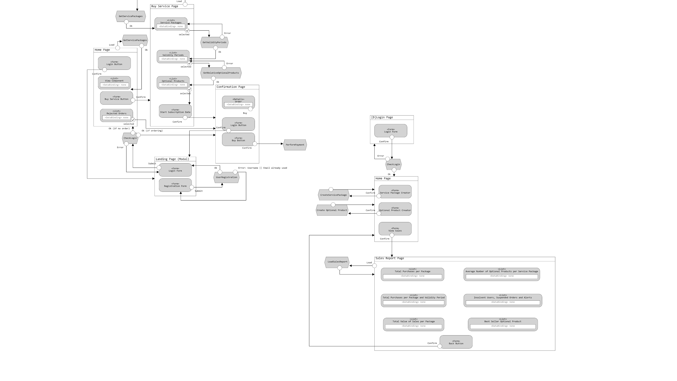
IFML
Employee Side
Customer Side

Slide 28
List of Components
Client Components
Servlets
User Registration
CheckLogin (Customer)
CheckLogin (Employee)
GetServicePackage
GetValidityPeriods
GetRelativeOptionalProducts
PerformPayment
CreateServicePackage
CreateOptionalProduct
LoadSalesReport
Views
Landing Page (Modal)
Login Page (Employee)
Home Page (Customer)
Home Page (Employee)
Buy Service Page
Confirmation Page (Modal)
Sales Report Page
Java Beans
Back End Components
Entities
User
Order
Service Package
Optional Product
Service
Validity Period
Service Activation Schedule
Alert
Business Components (EJBs)
BC1
(Stateless or Stateful)

Slide 29
Sequence Diagrams

